Slide 1

Market Research: INSOLAR
Presented by Joy Chang

Slide 2
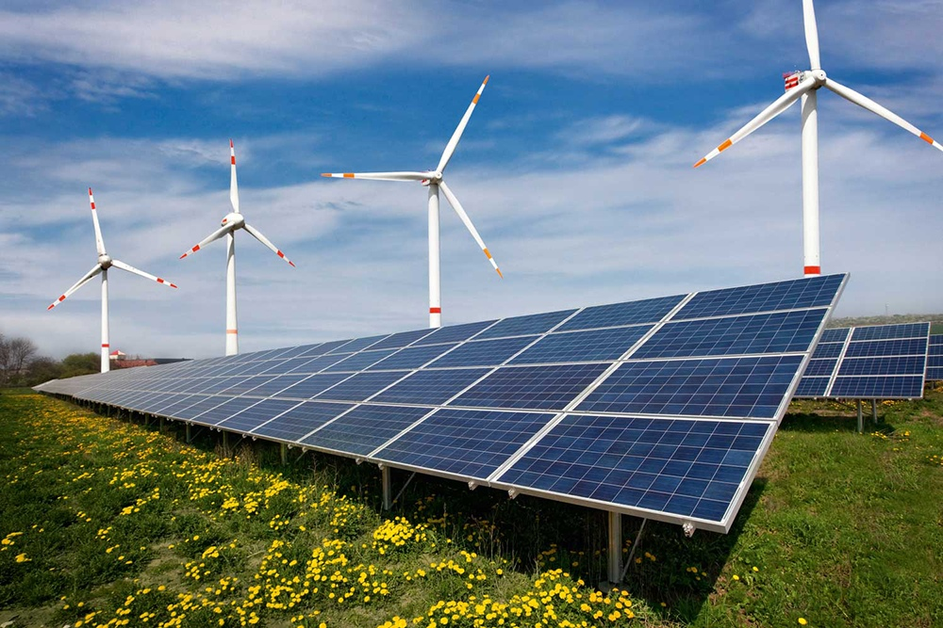

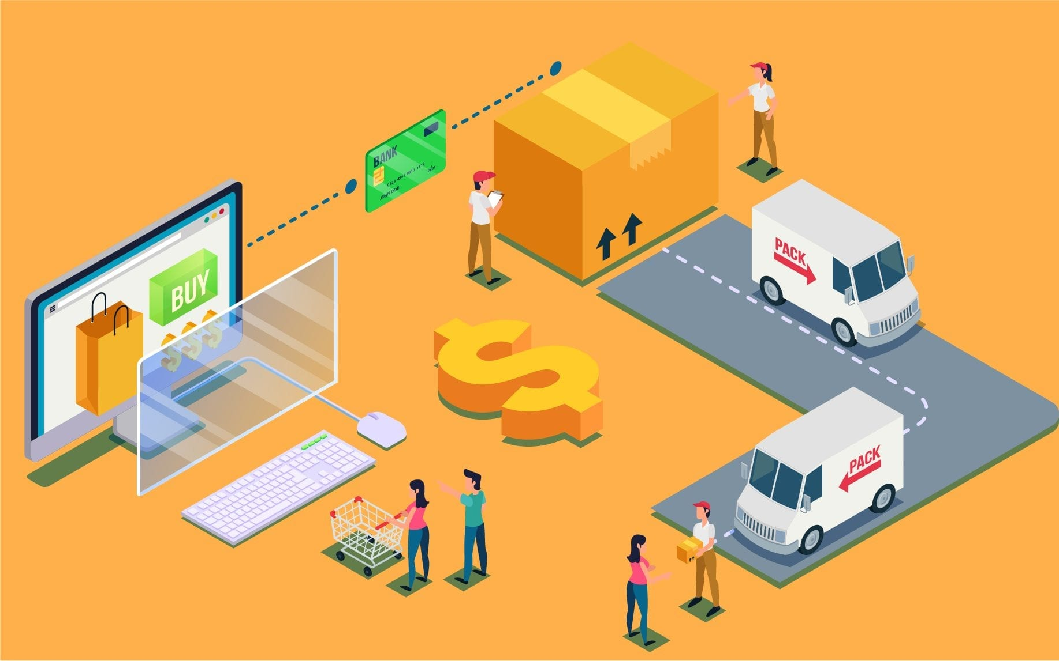
Market Overview
The business of INSOLAR intersects a few markets:
Renewable energy: solar energy and solar panels
Technology: its business is powered by AI
E-commerce: it connects the customers with the solar panel companies

Slide 3
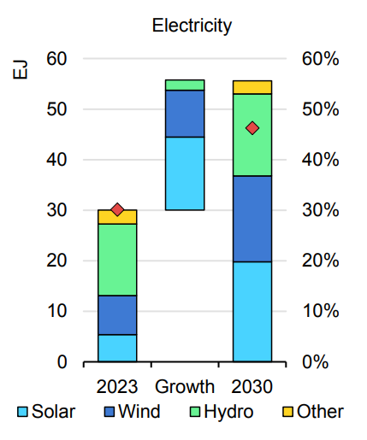
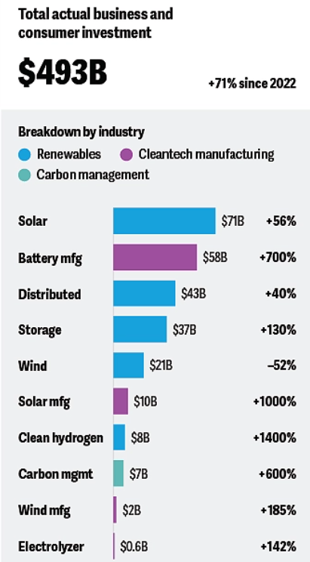
Renewable Energy & AI
Solar power in the renewable energy market
In 2024, the demand for and investment in renewable energy continued to grow, accounting to almost 90% of all new builds and expansions
Global renewable capacity is expected to grow by 2.7 times by 2030
As of 2024, solar became the fourth-largest source of installed capacity, which increased 88% compared to 2023
Industrial policies encourage local manufacturing of solar panels
Solar power & AI
AI is being increasingly leveraged to optimize the supply chains of solar panels
The industry is using AI to deploy and integrate the renewables that the industry
AI-powered robots help install large solar deployments in the desert powering data centers
The US Department of Energy has funded research using AI to accelerate the development of new circuit technologies to integrate remote renewable generation

Slide 4
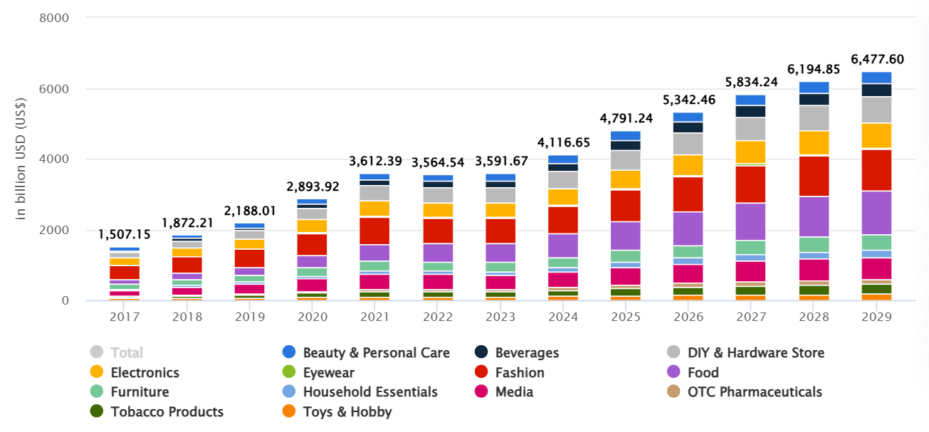
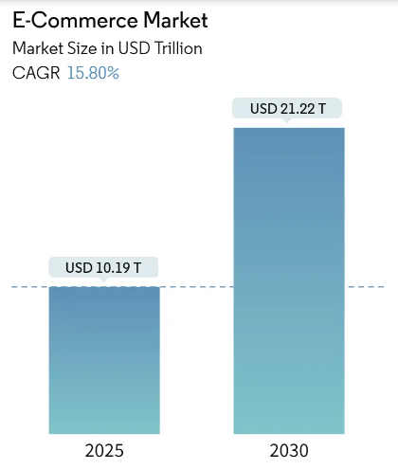
E-Commerce & AI
Solar industry in the e-commerce market
Revenue in the e-commerce market is projected to reach US$4,791 billion in 2025, with an expected annual growth of 7.83%
Consumers increasingly select the digital marketplace for a smooth shopping process and the ease of online buying
E-procurement is emerging as a preferred strategy to source solar panels and components
B2B solar marketplaces provide product buyers with a central location to request quotes and order supplies
E-commerce & AI
AI-powered chatbots, predictive analytics, and digital assistants have become essential components of e-commerce customer care
E.g., Amazon’s Alexa, Apple’s Siri, and Microsoft’s Cortana
Generative AI help e-commerce businesses write product descriptions

Slide 5

SWOT Analysis
Opportunities
Growing demand for renewable energy, among which solar solutions are the fastest-growing
Leveraging government incentives such as state and local rebates
Developing AI chatbots and predictive analytics
Threats
Larger, more established solar providers could imitate the features of INSOLAR
Changes in energy policies could impact INSOLAR’s business
Issues with AI systems could undermine customer satisfaction so it needs regular maintenance
Strength
Uses AI for instant, customized solar proposals
Cutting customer acquisition costs allows INSOLAR to offer prices up to 50% cheaper than other providers
Transparent purchase process and clear cost breakdown for customers
Comprehensive service covering designing, getting permits, installation, and working with utility
Weaknesses
Lack of physical, in-person stores
Could face challenges in building and selling a brand in the competitive market
Customers could be skeptical about AI-driven decisions

Slide 6
Key Competitors
Name | Revenue | Founder | Founded Year | Headquarter | Industry
INSOLAR | - | Ali Sina | 2017 | Irvine, CA | AI, Clean Energy, Solar, Sustainability
SolarReviews | $33.7M/year | Andrew Sendy | 2012 | Denver, CO | Clean Energy, Solar, Marketplace
EnergySage | $15M/year | Vikram Aggarwal | 2009 | Boston, MA | Energy Storage, Renewable Energy, Marketplace
Heliose | - | - | 2021 | Park City, UT | Energy Management, Solar

Slide 7
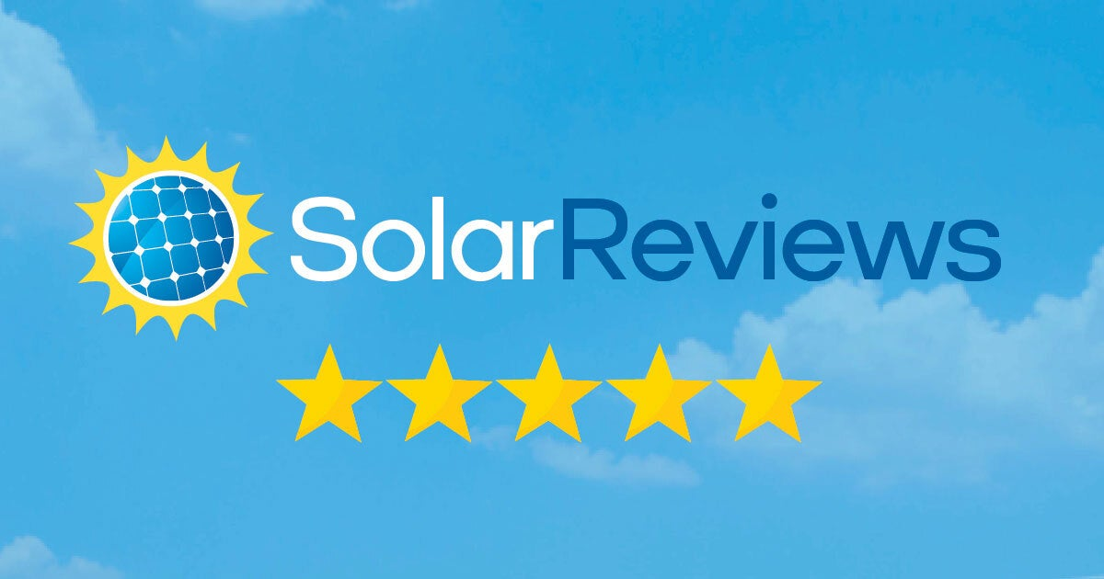
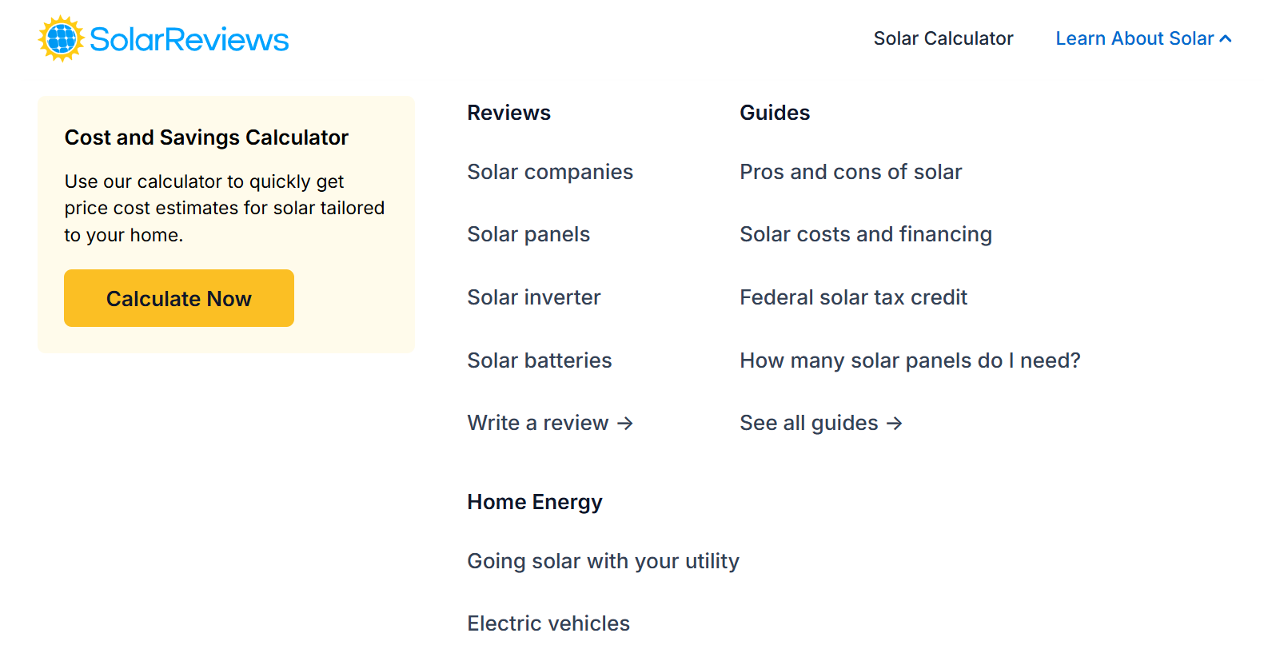
Key Competitor: SolarReviews
Strength: One-stop resource for solar info (i.e., solar companies, panels, inverters, batteries) Provides unfiltered, trustworthy reviews Data-driven ratings for panel installers Educational guides on solar costs, taxes credits, and financing Simple cost-and-savings calculator | Weaknesses: Primarily informational; doesn’t offer end-to-end solar services Quality and availability of solar installers may vary by location, potentially affecting customer satisfaction Facing strong competition from other solar marketplace and review platforms
Opportunities: Expanding educational content such as detailed guides and video tutorials Partnering with top-rated solar providers to offer exclusive discounts and services Diving deeper in local regulations on solar installations to provide insights on rebates and costs | Threats: Unprofessional and fake reviews on the platform could undermine customer trust High upfront costs of solar installations could deter customers during economic downturns
Website pros: clear and straightforward, has the essential solar calculator function at the home page

Slide 8
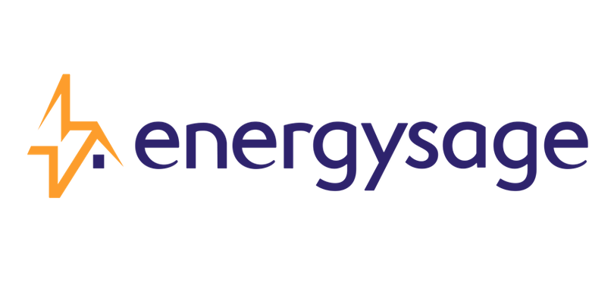
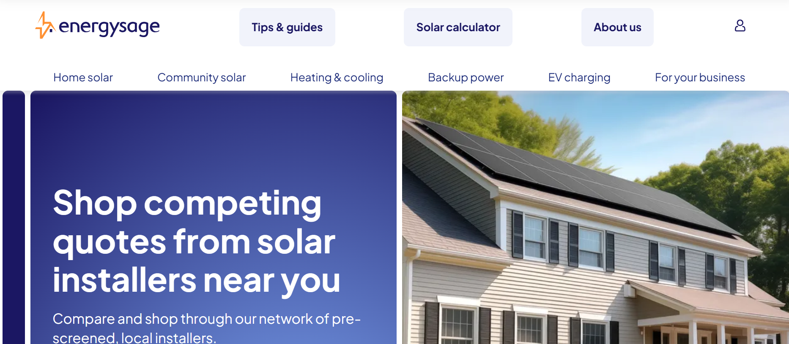
Key Competitor: EnergySage
Strength: Offering comparison tools for a wide range of clean energy solutions (i.e., solar, heat pumps, EV charging) Consumer-friendly as it provides pre-screened installer quotes Help users maximize saving through federal, state, and local rebates Community solar access | Weaknesses: A wide range of products and services may overwhelm customers Limited control over the quality of installation and maintenance services – it relies on third-party partners
Opportunities: Integrating more clean energy solutions such as wind power and smart home energy management Use AI and big data to recommend energy solutions for users based on their profiles Partnering with businesses to provide bundled and economic energy solutions | Threats: Competing with platforms such as SolarReviews and direct providers such as Tesla Solar The clean energy market is reaching saturation
Website: has its major businesses listed clearly on the home page. However, the overall website is not visual-appealing

Slide 9
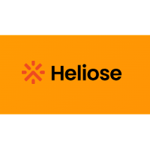
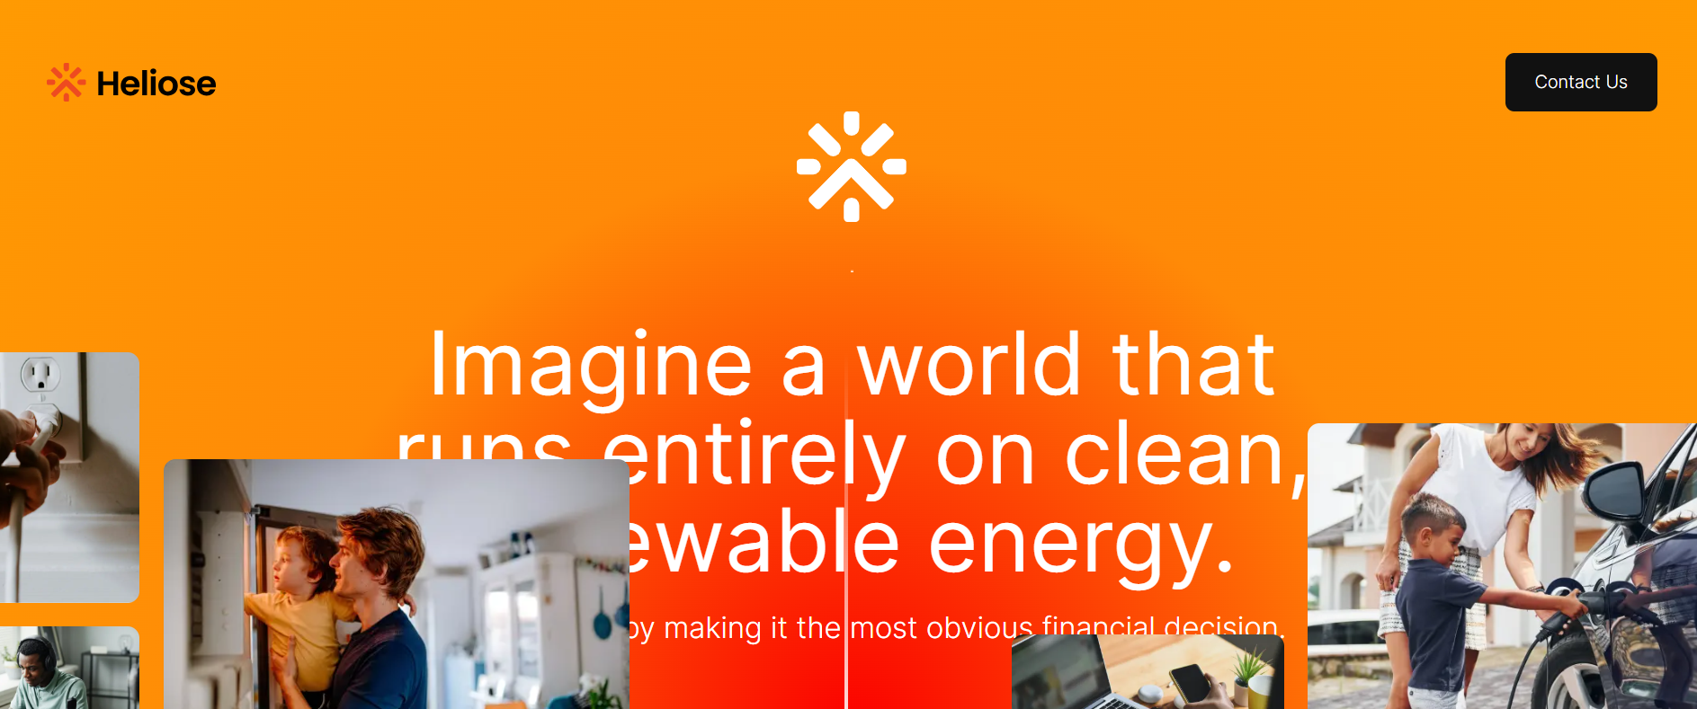
Key Competitor: Heliose
Strength: Aiming to reduce residential solar costs by 50% Cutting the post-sale installation timeline from 60 days to under 72 hrs Targeting the under-penetrated U.S. residential solar market Alignment with the trends (i.e., climate change mitigation and sustainable solutions | Weaknesses: As a new company, Heliose has limited customer base Small-scaled company with limited number of employees and resources Reducing costs and installation timelines significantly seems to be challenging and suspicious
Opportunities: Its low cost and short installation timeline are intriguing. Heliose can sell more about this It can seek more collaborations with installers, lenders, and distributors Leveraging its vertical software solution to offer unique features like real-time quotes | Threats: Customers tend to choose larger, more credible solar companies with extensive resources Heliose’s goals are ambiguous – it is hard to tell what its selling point is
Website: strong, captivating color choice. However, it only has key metrics on the home page but without any essential functions. It could move its “get a quote” to the top of the page

Slide 10
Source
https://www2.deloitte.com/us/en/insights/industry/renewable-energy/renewable-energy-industry-outlook.html
https://www.iea.org/reports/renewables-2024
https://www.grandviewresearch.com/industry-analysis/e-commerce-market
https://www.statista.com/outlook/emo/ecommerce/worldwide
https://www.crunchbase.com/organization/energysage
https://www.crunchbase.com/organization/solarreviews
https://www.crunchbase.com/organization/heliose

